Slide 1


"Quantifying Public Landscape Perceptions with Multimodal Learning" Bilal Rabbi, Barkin Yarici, Waleed Niaz

Slide 2

Key Questions
How effective are unimodal deep learning models like BERT (for text) and ResNet50 (for images) in classifying landscape scenicness?
Can the multimodal ViLT model outperform unimodal approaches like ResNet50 for image analysis and BERT for textual analysis in providing more accurate and holistic quantification of landscape scenicness?

Slide 3
Data Acquisition & Preprocessing
Dataset: "Scenic or Not" from geograph.org.uk. Contains: ~210,000 landscape images with textual comments and metadata.
Data Integration: Harmonization of multiple files: votes.tsv, scenicornot.csv, gridimage_text.csv. Key linking attribute: gridimage_id.
Data Integrity: Excluded entries with missing Geograph URIs or comments.
Textual Preprocessing: Contraction expansion, HTML tag removal, and lemmatization.
Outcome: Robust and clean dataset ready for ML models.
Code is linked here

Slide 4
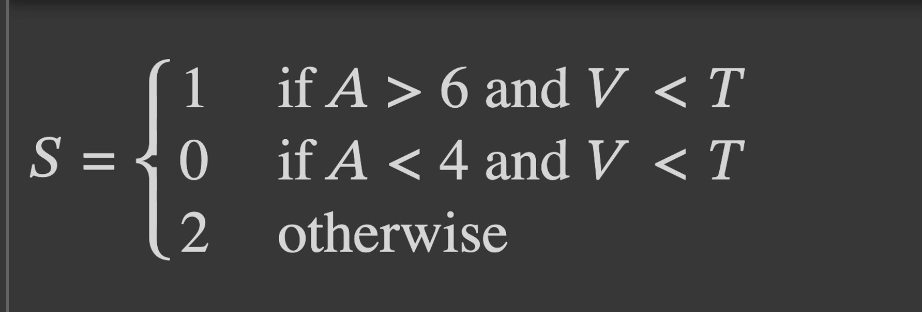
Data Acquisition & Preprocessing
Feature Engineering: Derived metrics: Average (A), Threshold (T) and Variance (V) from voting data for scenicness representation.
Classification (S) based on A and V:
S=1 (Scenic), S=0 (Non-scenic), S=2 (Other cases).

Slide 5

Quantitative Analysis Metrics
In assessing our machine learning models, we employed various accuracy metrics, including accuracy, F1-score, precision, and recall.
F1 Score: The F1 score is like the harmonious balance in a choir performance. It's the sweet spot where precision and recall harmonize to create a well-rounded and pleasing outcome.
Precision: Precision is like a skilled archer hitting the bullseye. It's about being precise and accurate in hitting the target.
Recall: Recall is like a safety net that catches all the circus performers when they fall. It ensures that nothing or no one is left behind.
In summary, F1 score, precision, and recall work together in a delicate dance to balance accuracy, completeness, and precision in the model's predictions. They help us understand how well the model performs in identifying positive instances while avoiding false positives and ensuring nothing is overlooked.

Slide 6

Qualitative Analysis Metrics
We focused on examining the performance of our models on a selection of data points that represent different scenicness levels. We categorized the scenicness levels into four groups based on average scenicness scores:
1. Highly Scenic (Average: 9.6)
2. Moderately Scenic (Average: 6.4)
3. Low Scenic (Average: 2.25)
4. Very Low Scenic (Average: 1.0)
This categorization allowed us to assess how well each model performs across a range of scenicness levels.

Slide 7

BERT
The model is “BertForSequenceClassification”, Bert-Base-Uncased” treats uppercase and lowercase letters the same way.
The bidirectional approach enables it to consider both the left and right context of each word.
BERT consists of a stack of 12 layers (0-11), each containing a “BertLayer.” These layers work together to refine the representations of words through self-attention.
Inside each “BertLayer,” a self-attention mechanism helps sequences relate to each other. It involves linear transformations (query, key, and value) and dropout for regularization.
BERT uses the GELU (Gaussian Error Linear Unit) activation function in Bert Layers, Tanh in final pooling layer.
Code is linked here

Slide 8
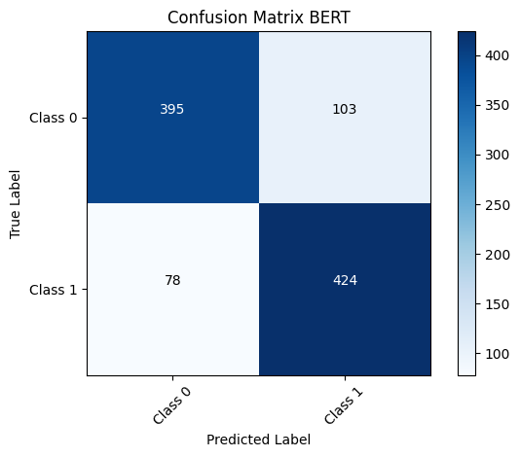
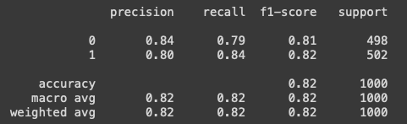
Quantitative Results BERT
F1 scores indicate that the model is performing slightly better in terms of a balance between precision and recall for Class 1.
The F1 scores for both classes are relatively close to each other (0.81 for Class 0 and 0.82 for Class 1). This suggests that the model is achieving a balanced performance.
An F1 score in the range of 0.8 is often considered a good performance in binary classification tasks. It indicates that the model is effective at both making accurate positive predictions (precision) and capturing actual positive instances (recall) for both classes.

Slide 9
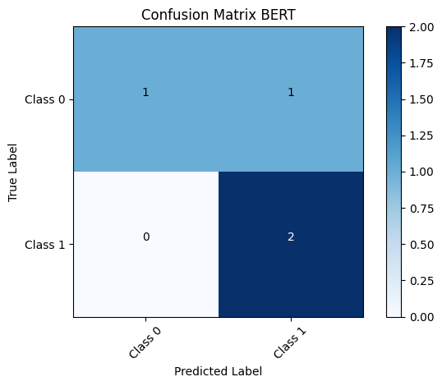
Qualitative Results BERT
The model incorrectly predicted 3rd data point as Class 1 (Positive) when the true label is Class 0 (Negative). The comment text contains phrases like "road like Yorkshire valley" and "buildings," which might have led the model to misinterpret it as positive.
This suggests that the model may need to improve its understanding of context or specific phrases. Also, the model made a mistake by thinking a 'Low Scenic' scene was positive, which shows it needs to understand the context better.

Slide 10
ResNet50
Key Features:
Pretrained Model on millions of images
Convolutional Layers: Detect essential image features like edges and colors.
Activation (ReLU): Highlights vital parts for decision-making.
Pooling: Condenses image data, retaining core details.
Residual Blocks: The heart of ResNet - uses shortcuts for faster learning by skipping certain layers which is not contributing to new learning.
Model test code linked here

Slide 11
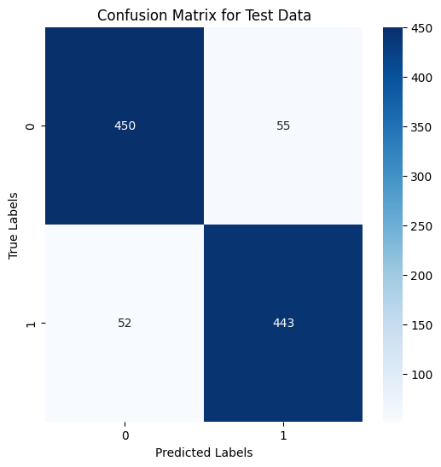
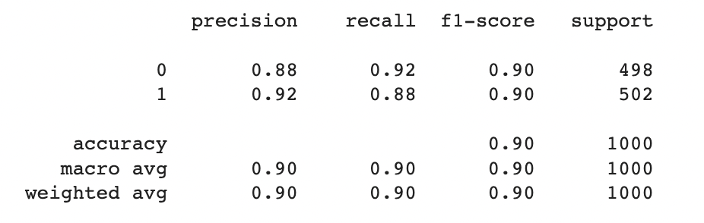
Quantitative Results ResNet50
The F1 scores for both classes are the same 0.90. This suggests that the model is achieving a balanced performance.
The model has demonstrated a commendable performance on the test data with an accuracy of 90%. It's noteworthy to observe that the precision and recall metrics are in harmony, leading to an F1 score of approximately 0.897, signifying that the model maintains a balanced capability in both accurately predicting positive instances and capturing the actual positive instances.

Slide 12
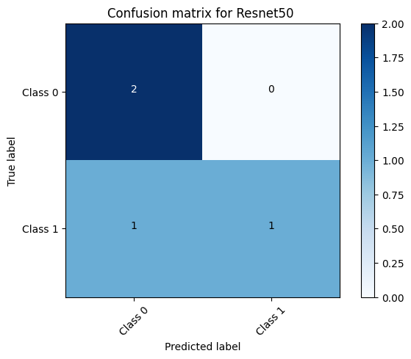
Qualitative Results ResNet50
The model correctly identified 2 samples as Class 0.
The model correctly identified 1 sample as Class 1.
The model incorrectly identified 1 sample of Class 1 as Class 0.
There were no other misclassifications.

Slide 13
ViLT
Key Features:
For Classification Pretrained Model on VQAv2 and NLVR2
Apply a two-layered neural network on top of the pre-trained model and fine-tune this combined structure
Text: Bert-base-uncased tokenizer to tokenize text inputs.
Image: The image is resized to the length of 512 x 384pixels, patched into 240 squares [max 200 is used], padded and then used
Code is linked here
In essence, through the combination of joint embeddings, the transformer's attention mechanisms, and specific training objectives, ViLT learns to understand and find relationships between text and images during its training process.

Slide 14
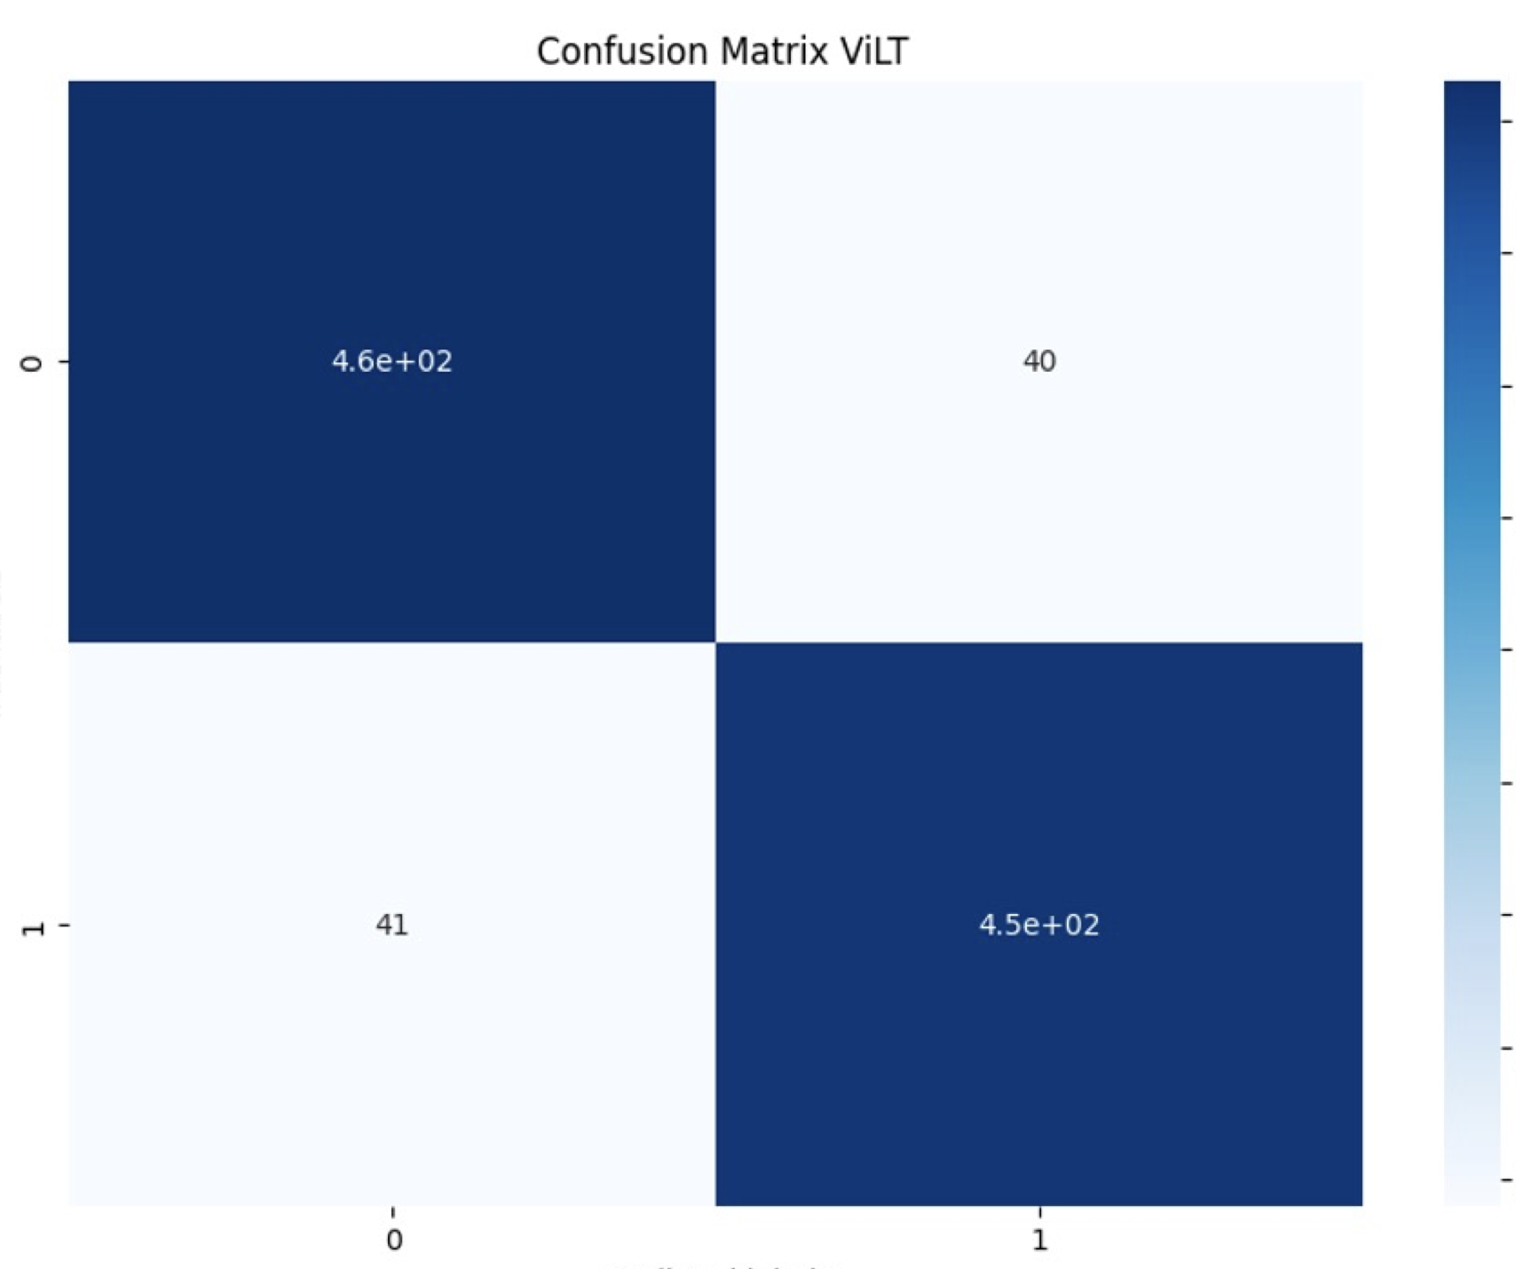
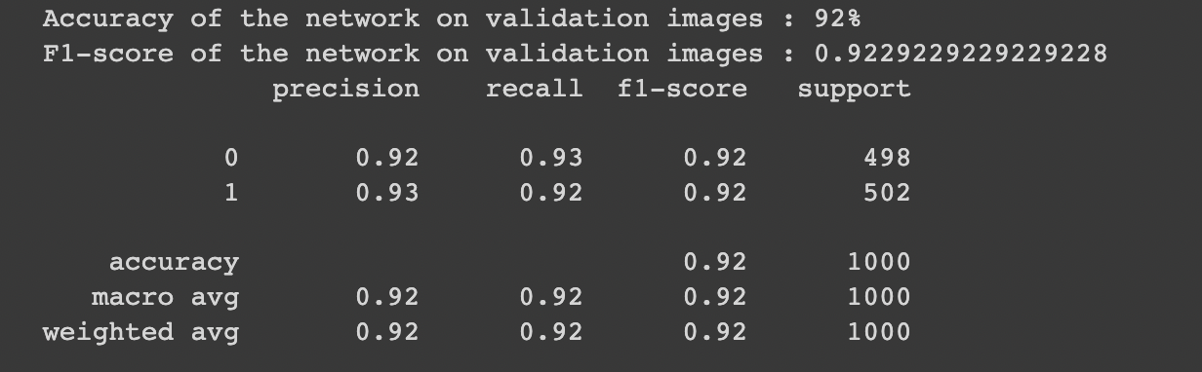
Quantitative Results ViLT
F1 scores indicate that the model is performing slightly better in terms of a balance between precision and recall for Class 1.
The F1 scores for both classes are the same 0.92. This suggests that the model is achieving a balanced performance.
An F1 score in the range of 0.92 is considered a good performance in binary classification tasks. It indicates that the model is effective at both making accurate positive predictions (precision) and capturing actual positive instances (recall) for both classes.

Slide 15
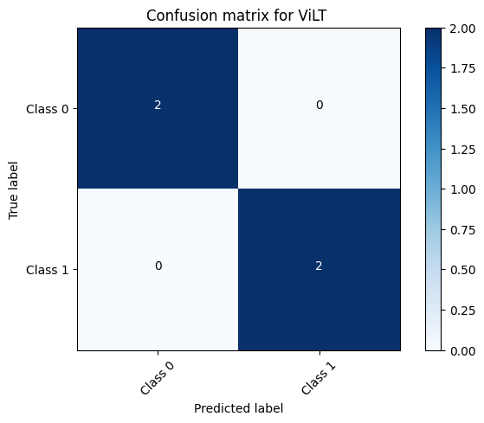
Qualitative Results ViLT
The model correctly identified 2 samples as Class 0.
The model correctly identified 2 samples as Class 1.
There were no misclassifications.

Slide 16
Qualitative Results ViLT
The model accurately identifies higher scenicness values in most cases. However, it encountered an oversight in some instances when failing to recognize a very high scenicness score of 9.6 and marking it as 0.
For mid-range and low scenicness scores, the model appears to be performing accurately, as evident from its correct predictions for scenicness scores of 6.4, 2.25, and 1.0.
In conclusion, while ViLT demonstrates competence in predicting mid-range and low scenicness values, its performance on higher scenicness scores requires only in some cases attention and refinement.

Slide 17
Conclusion
"In this study, we addressed two questions of our research:
We evaluated the effectiveness of unimodal models, using BERT for text analysis and ResNet50 for image analysis.
We explored whether the multimodal ViLT model could outperform these unimodal approaches.
Quantitatively, ViLT demonstrated exceptional performance with 92% accuracy, outperforming ResNet50 (90%) and BERT (82%). While the numbers showcase ViLT's superiority, qualitative analysis revealed real-world weaknesses in all models, emphasizing the need to consider both qualitative and quantitative aspects.
In conclusion, ViLT excels in accurate and holistic scenicness quantification, offering valuable insights and highlighting the importance of comprehensive real-world evaluation."

Slide 18

Thank you

